Slide 1
CAREWAVE
TEAM- 16
1

Slide 2





MEET OUR TEAM
Prof. Dona Mary Cherian
Meenu Susan Mony
Emy Joshy
Assistant Professor
Dept. of CSE
Our Guide
Swathilekshmi S
2
Georlit George

Slide 3

TABLE OF CONTENTS
PROBLEM STATEMENT
LITERATURE SURVEY
OBJECTIVES
MODULES
REQUIREMENT ANALYSIS
DESIGN DIAGRAMS
MODERN TOOLS USED
TECHNOLOGY STACK
GANTT CHART
REFERENCES
3
CONCLUSION

Slide 4
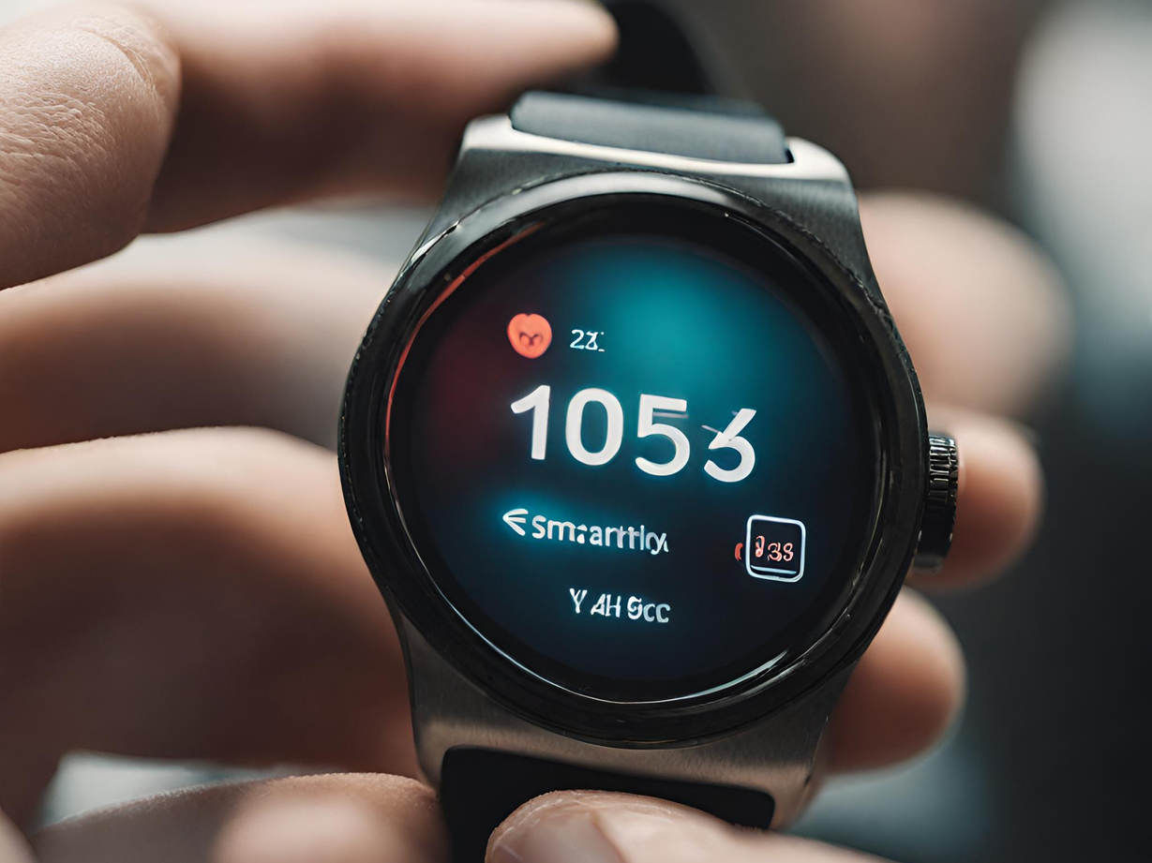
PROBLEM STATEMENT
The aging population and individuals with health conditions lack a comprehensive healthcare solution tailored to their needs. Existing systems fall short in providing personalized health management and swift emergency response. This gap results in challenges such as delayed interventions and insufficient remote monitoring. The problem statement calls for the development of an innovative AI-powered software for smartwatches to bridge these gaps and improve the well-being of this vulnerable population.
4

Slide 5

LITERATURE SURVEY
Research Papers
Existing similar software
5

Slide 6
Research Papers
Title: Real-time artificial intelligence based health monitoring, diagnosing and environmental control system for COVID-19 patients
Authors: Muhammad Zia Ur Rahman, Ali Hassan Raza, Abeer Abdulaziz AlSanad, Muhammad Azeem Akbar, Rabia Liaquat, Muhammad Tanveer Riaz, Lulwah AlSuwaidan, Halah Abdulaziz Al-Alshaikh, Hatoon S Alsagri
Journal: Mathematical Biosciences & Engineering
Volume: 19
Issue: 8
Year:2022
Summary:
This paper presents a real-time artificial intelligence-based health monitoring, diagnosing, and environmental control system for COVID-19 patients.
The system utilizes locally available sensors and IoT technology to track the health parameters of isolated COVID-19 patients in remote areas.
It provides live location tracking, GSM messages, and email alerts to doctors during emergency conditions.
The system incorporates intelligent neural networks for training and diagnosis, and it can automatically prescribe medication in the absence of a doctor.
The implementation results are discussed, including a comparison with existing IoT-based health monitoring systems. The paper concludes by highlighting the benefits of the proposed system in remote patient monitoring and suggesting future work for improvement.
6

Slide 7
Research Papers
Title:Smart Health Monitoring Using Deep Learning and Artificial Intelligence
Author: Suma K G
Publication Date: May 2023
Journal: Revue d'Intelligence Artificielle
Summary:
The paper discusses the use of deep learning and artificial intelligence in smart health monitoring systems, exploring various applications and techniques for data analysis and prediction in healthcare.
The document explores the applications of smart health monitoring in various healthcare areas, such as intensive care, medication management, and oxygen saturation monitoring.
It also addresses the challenges and limitations in smart health monitoring, including power management, data standardization, and data security.
Overall, the document provides insights into the potential benefits and challenges of implementing smart health monitoring systems and suggests future directions for research in the field.
7

Slide 8
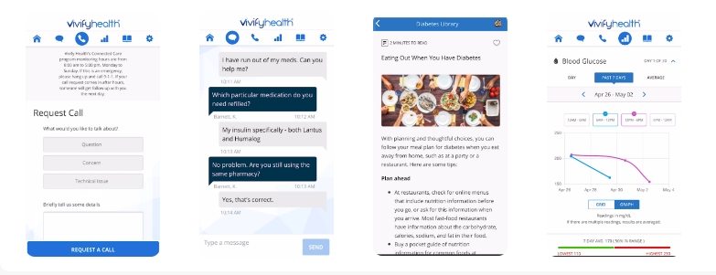
Existing similar software
VIVIFY HEALTH
Vivify Health is a cloud-based remote care solution that helps businesses in the healthcare industry design personalized care plans and monitor patient status.
It enables users to build bundled health programs by analyzing patient data related to pre-op assessments, post-discharge monitoring, compliance documentation and more.
Vivify Health facilitates integration with several third-party EHR solutions, ensuring quick access to patient medical records.
Mobile applications for Android and iOS devices are also offered, allowing users to remotely manage all activities..
8

Slide 9
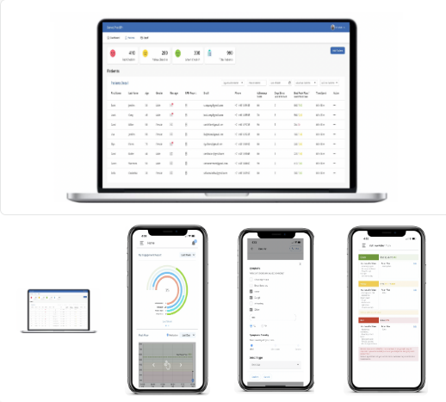
Existing similar software
KEVA HEALTH
Keva Health's SaaS Respiratory Care Platform for physicians captures the complete patient journey with consistent and accurate capture of remote care data outside the physician's office or hospital.
It does this by ensuring that patients follow physician provided action plans, improve their adherence, and also provide just-in-time education when they are at home.
The platform provides automated virtual check-ins and the ability
to review remote patient monitoring (RPM) reports. Hospitals and clinics
can get reimbursed for services provided through use of KEVA platform
virtually with very little overhead.
This leads to better patient outcomes and lower costs for chronic diseases.
9

Slide 10
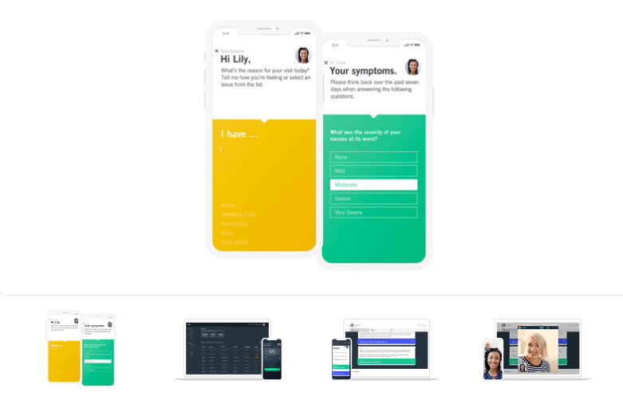
Existing similar software
HALE
Hale is a remote patient monitoring platform, enabling clinical teams and health care practices to gain real-time health data without the need for on-site consultations.
The platform enables patient medical records to be updated with data collected from the patient mobile app, while medical practitioners can upload media and data from appointments, test results, and care plans.
This provides up-to-date information on patients’ health status for making informed diagnoses and care plans. With Hale automated messages and reminders, patients can be reminded of upcoming appointments, as well as notified of any changes or amendments.
Using live chat, patients and medical staff can communicate in real-time regarding last-minute changes to appointments or health status updates, enabling practitioners to stay informed of status changes without the need for an appointment.
Starting price: $59.00 per month
10

Slide 11
Objectives
Enhance Medication Adherence
Improve Health Monitoring and Early Intervention
Facilitate User-Caregiver Collaboration
11

Slide 12
REQUIREMENT ANALYSIS
12

Slide 13
FUNCTIONAL REQUIREMENTS
Vital sign monitoring
Medication reminders
Alert messages
Emergency SOS
Personalised weekly health report
13

Slide 14
NON-FUNCTIONAL REQUIREMENTS
Performance
Reliability
Compatibility
Usability
Security
14

Slide 15
DESIGN DIAGRAMS
15

Slide 16
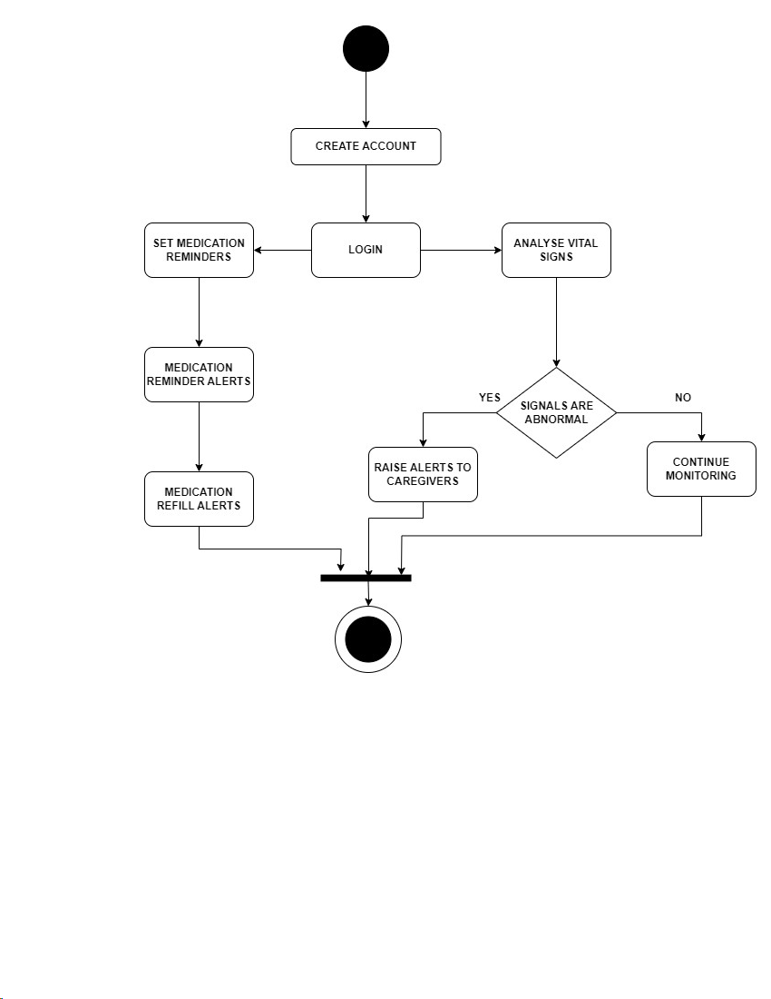
ACTIVITY DIAGRAM
Page 09
16

Slide 17
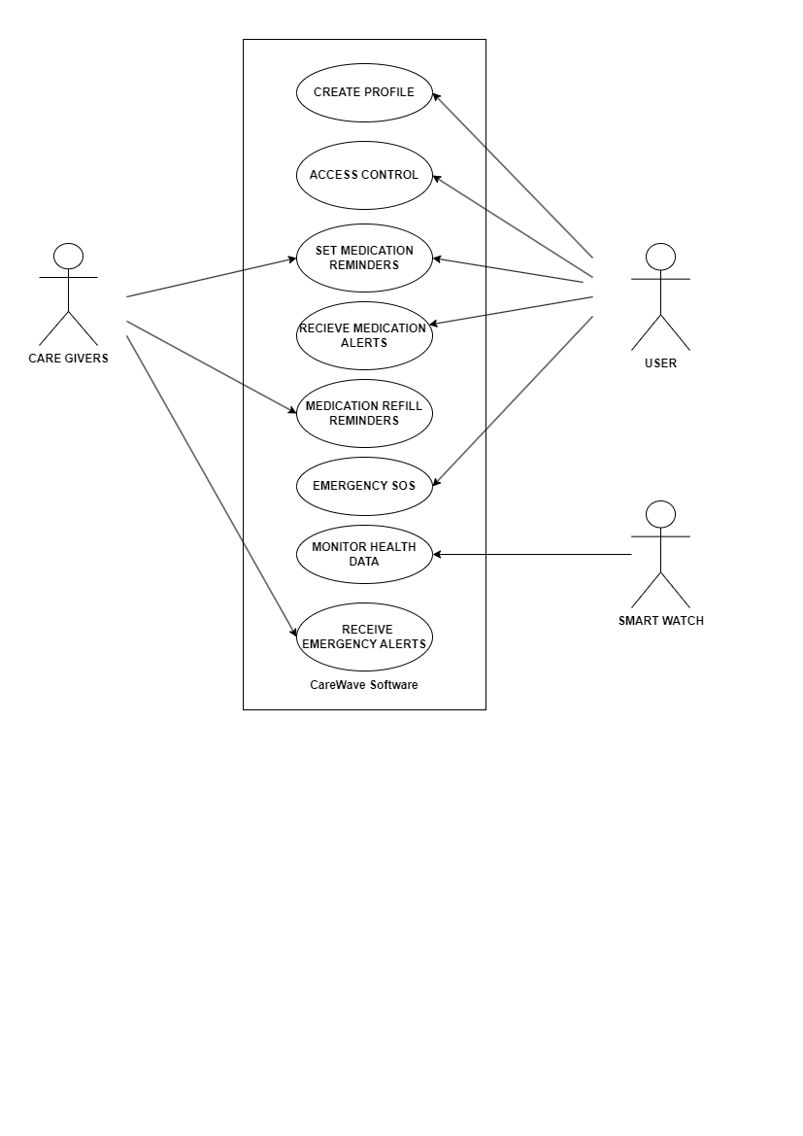
USECASE DIAGRAM
17

Slide 18
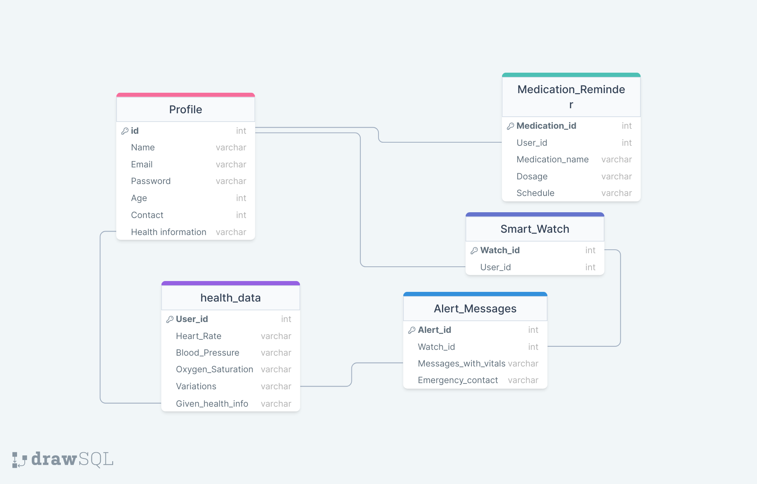
SCHEMA DIAGRAM
18

Slide 19
MODULES
Sign in using google
Basic details
Caregivers details and contact number
Medication details
Vitals collection
Monitoring
Save data
Values to verify(max and min limits)
Medication alerts with medicine name and dose along with voice prompt
Caregivers details
Alert messages with vital details
SOS call to hospitals at emergency
User
Data
Alert
19

Slide 20

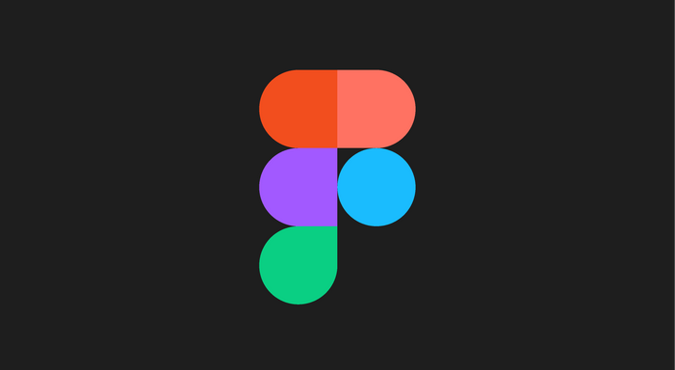

MODERN TOOLS USED:
Figma
Github
https://github.com/CareWave-project/CareWave
20

Slide 21



TECHNOLOGY STACK
MongoDB
Flutter
FireBase
Python
TensorFlow
21

Slide 22
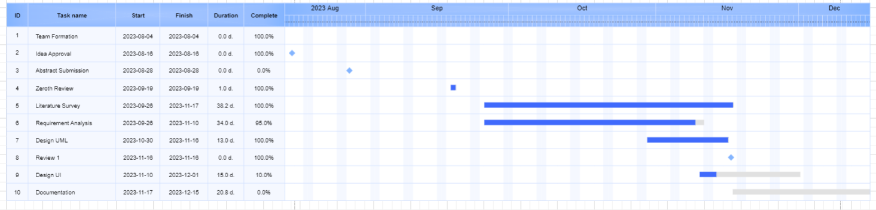
GANTT CHART
22

Slide 23
CONCLUSION
CareWave has the potential to be a valuable tool for individuals seeking to improve their health and well-being. By combining real-time heart rate monitoring with AI capabilities, and the incorporation of medication reminders and alerts,the application can provide users with personalized insights into their health and identify potential risks.
23

Slide 24
REFERENCES
Philip, Jeethu, et al. "Smart Health Monitoring Using Deep Learning and Artificial Intelligence." Revue d'Intelligence Artificielle 37.2 (2023).
Rahman, Muhammad Zia Ur, et al. "Real-time artificial intelligence based health monitoring, diagnosing and environmental control system for COVID-19 patients." Math. Biosci. Eng 19.8 (2022): 7586-7605.
Rathi, Vipin Kumar, et al. "An edge AI-enabled IoT healthcare monitoring system for smart cities." Computers & Electrical Engineering 96 (2021): 107524.
24

Slide 25
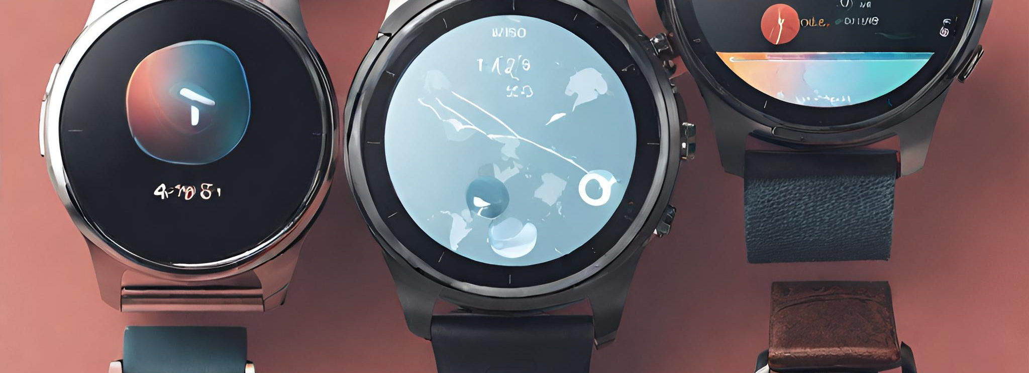
THANK YOU
25

